Slide 1

TIME SERIES FORECASTING WORKSHOP
Presented by
Matthew Erxleben

Slide 2
New member sign-up link:
https://bit.ly/dsc-22-signup

Slide 3
Workshop Outline
What is time series data? What is forecasting?
Common time series forecasting models
Seasonality
Stationarity and Differencing
Autocorrelation
Autoregression (AR)
Moving Average (MA)
ACF and PACF
ARIMA Model in code

Slide 4


Prerequisite Knowledge
Python
Basic Statistics
Beginner level data libraries (pandas, matplotlib, numPy)
Experience with Jupyter Notebooks

Slide 5
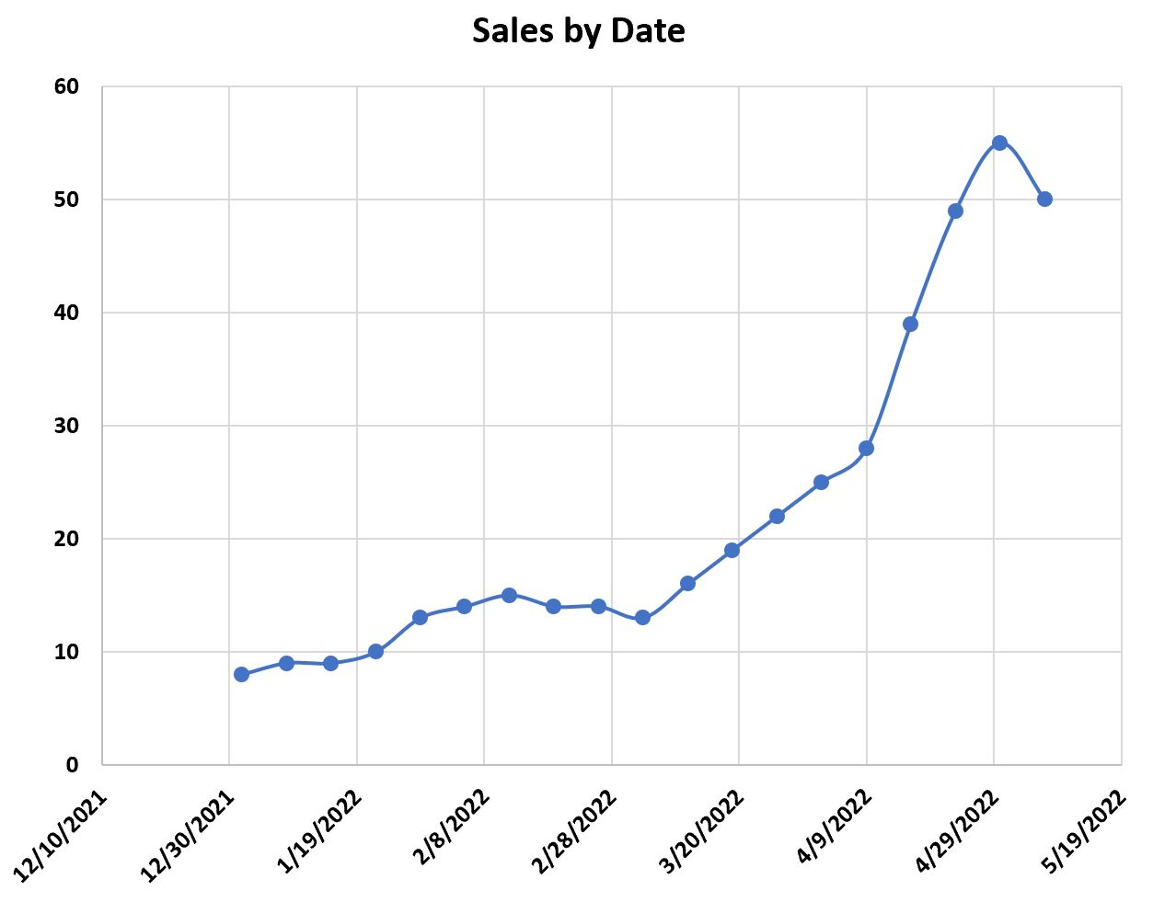
What is time series data?
Time series data is historical data that has a singular value per unit of time
E.g:
Weekly sales of bananas at the grocery store
There is only 1 number of banana sales the store had on a given week
Common time series datasets:
Sales
Stock prices
Daily temperatures
An individual's weight
Etc …

Slide 6
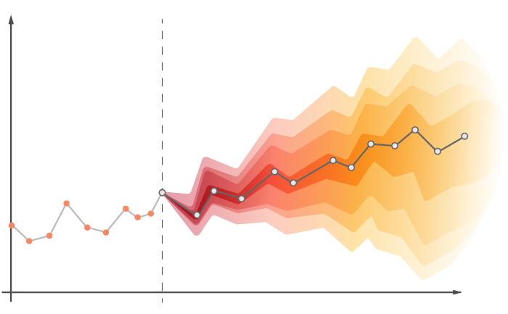
What can we do with time series data?
The data might have some trends or relationships to each other: Autocorrelation, Seasonality, External factors…
Based on the data’s relationships we can forecast into the future and predict what a value will be in X amount of time
E.g:
Predicting how many bananas the grocery store will sell next week
Notes:
Show basic graph of time series data loaded into Jupyter notebook

Slide 7
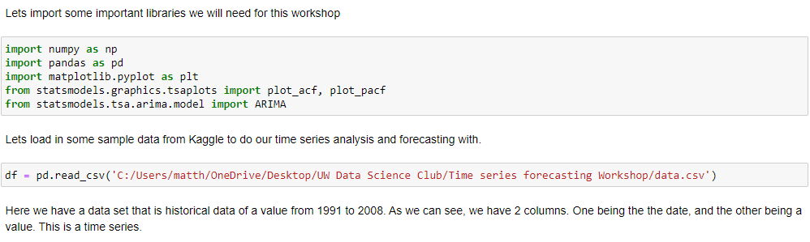
Importing Libraries + Data

Slide 8
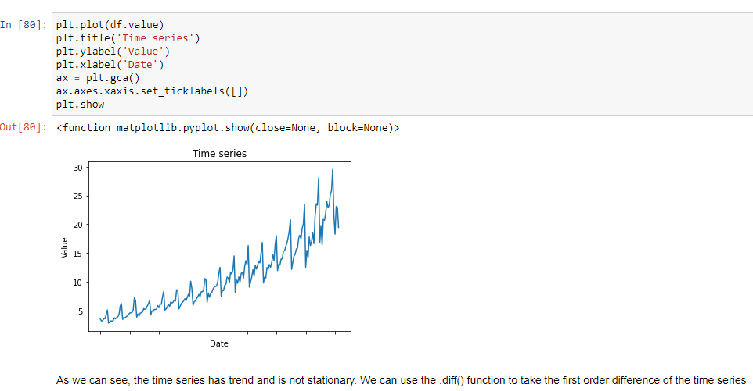
Time Series Data

Slide 9
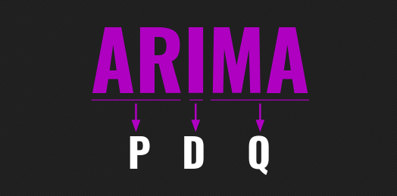
Commonly used time series forecasting models
AR (Autoregression)
MA (Moving average)
ARMA (Autoregressive moving average)
ARIMA (Autoregressive integrated moving average)

Slide 10
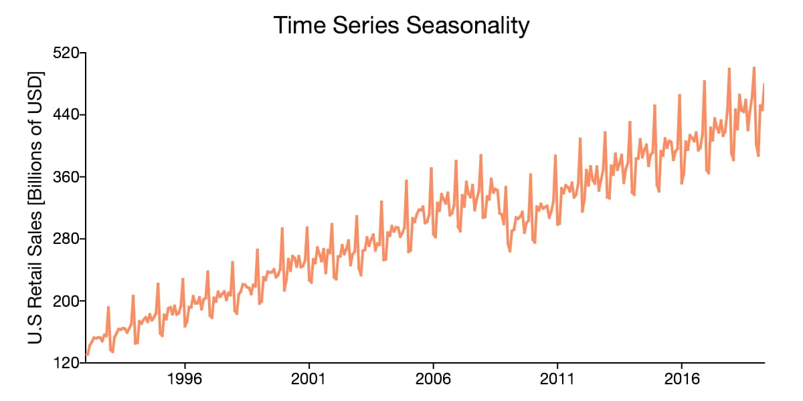
What is Seasonality?
Seasonality is a trend that occurs in time series data
This trend is a predictable change that recur every calendar year
E.g.
Sales at retail stores increase every December due to Christmas shopping

Slide 11
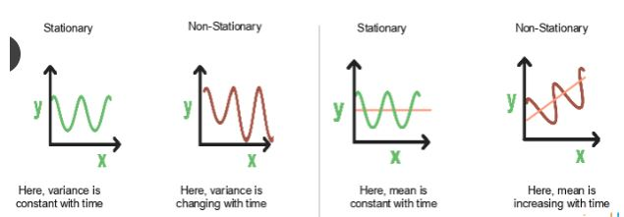
What is Stationarity?
Stationarity requires:
Constant Mean
Constant Standard Deviation
No seasonality
We need a time series to be stationary to do forecasting
How do we make a time series stationary?

Slide 12
What is Differencing?
Differencing:
Taking the difference between consecutive values in a series
E.g.
Banana sales last week = 10
Banana sales current week = 15
Difference: 15 - 10 = 5
Used to make the time series stationary
Order of differencing: number of times differencing needs to occur to a time series for it to become stationary
Notes:
Jupyter notebook show data set being differenced

Slide 13
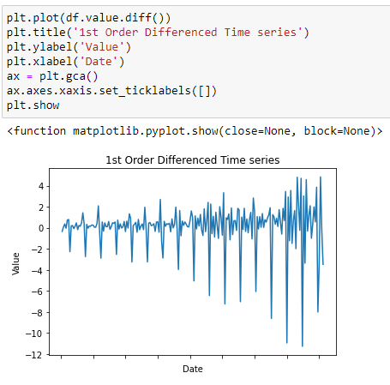
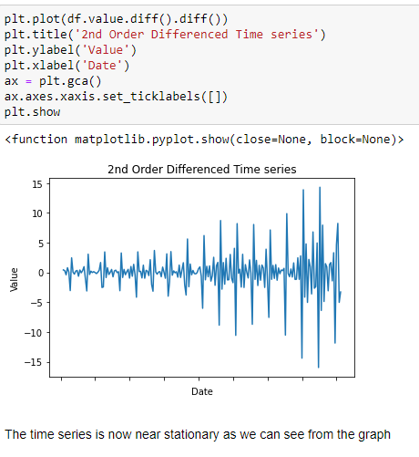
1st Order Differencing
2nd Order Differencing

Slide 14
What is Autocorrelation?
Autocorrelation means that the data has a relationship with its own historical data
E.g.
The amount of bananas that were sold last week has an effect on the current week's banana sales

Slide 15
What is Autoregressive model (AR)?
AR model: uses previous data to forecast future data (as there is an autocorrelation)
Lag: previous data point that is used to predict future data point
AR(p):
p is a parameter to represent how many lagged terms are used
E.g:
We saw correlation between previous weeks banana sales and current weeks banana sales, therefore use previous weeks sales to forecast future banana sales
Can be the previous week (p = 1), previous 2 weeks (p = 2), etc…

Slide 16
What should p equal? (AR(p))
PACF (Partial Autocorrelation Function): Direct correlation between a lag and its series. This test excludes the contributions from the intermediate lags.
We can use this to see which lags are significant and which are not in an AR(p) model
p = Number of significant lags found in the PACF test
Notes:
Show PACF test in Jupyter Notebook

Slide 17
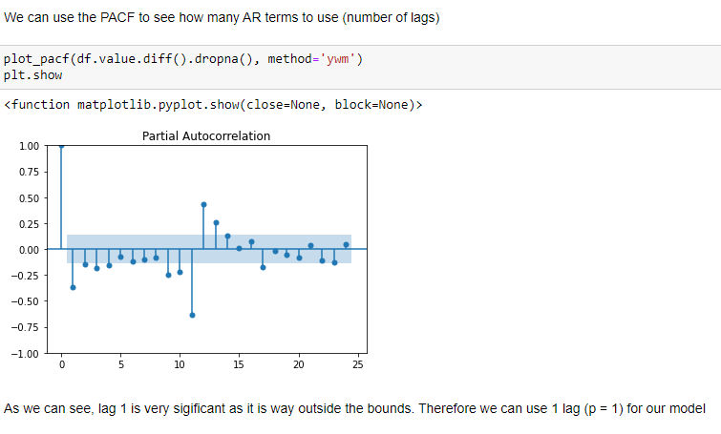
PACF:

Slide 18
What is Moving Average (MA)?
MA model: uses previous lags errors to forecast future data
MA(q):
q is a parameter to represent how many lagged forecast errors terms are used
E.g:
Model that predicts expected banana sales based on the error of banana sales in the previous week
Can be the error from previous week (q = 1), previous 2 weeks (q = 2), etc …

Slide 19
What should q equal? (MA(q))
ACF (Autocorrelation Function): Non-direct correlation between a lag and its series. This test includes the contributions from the intermediate lags.
We can use this to see which lags are significant and which are not in an MA(q) model
q = Number of significant lags found in the PACF test
Notes:
Show ACF test in Jupyter Notebook

Slide 20
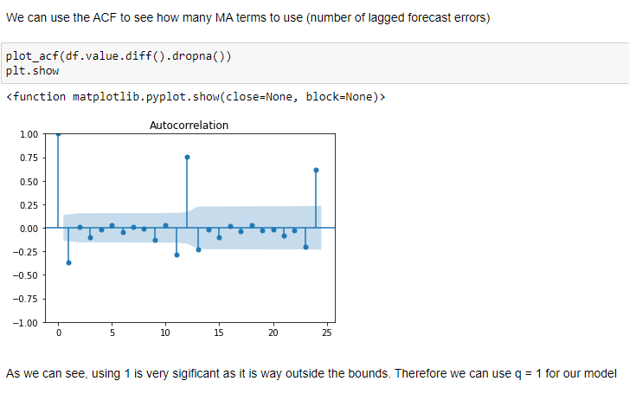
ACF:

Slide 21
What is ARIMA?
ARIMA (Autoregressive integrated moving average): Combining an AR with a MA model, and have it be stationary (this is what integrated means).
ARIMA(p, d, q):
p = number of lagged terms used
d = order of differencing
q = number of lagged forecast errors terms used
We can use this model to forecast our time series data!
Notes:
Jupyter notebook actually train and test the ARIMA model in statsmodels

Slide 22
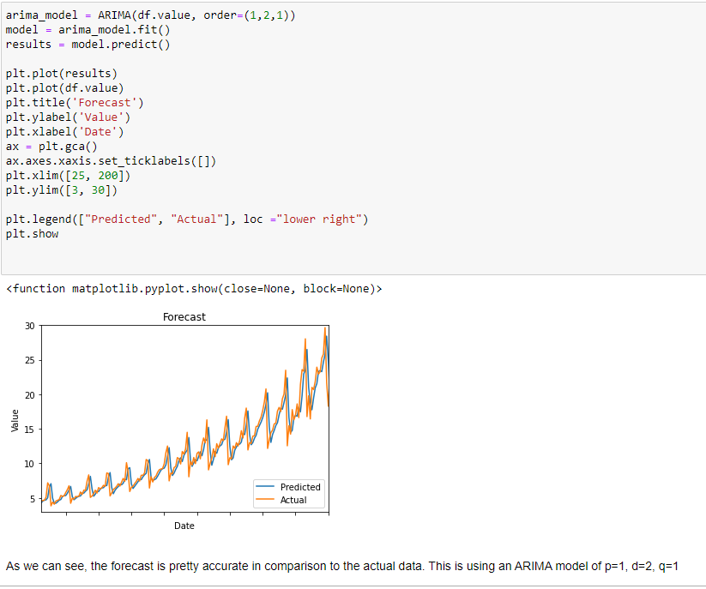
ARIMA Model:

Slide 23
Thanks for listening!
Any Questions?

Slide 24
Please leave feedback at this link:
https://forms.gle/H87MdhT1h3sDruQQ7
I appreciate all the feedback I can get! :)

